Slide 1
CS 540 Network Architecture
Lecture 16 : Inter-datacenter WAN
Prof. Younghee Lee

Slide 2

Why open system? Data Center
Example: New data center
Cost
200,000 servers
Fanout of 20 a 10,000 switches
$5k commercial switch a $50M
$1k custom-built switch a $10M
Savings in 10 data centers = $400M
Control
Optimize for features needed
Customize for services & apps
Quickly improve and innovate

Slide 3
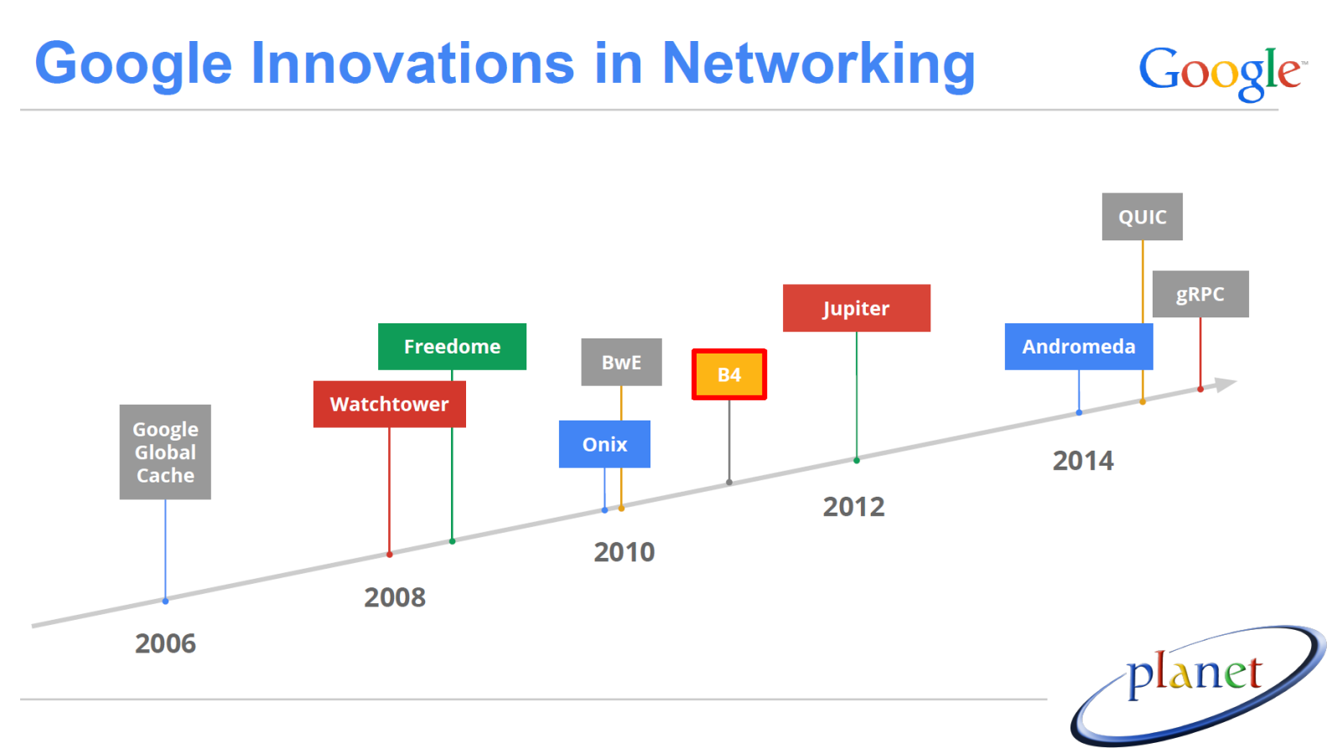
Google Networks
Google Networking
https://atscaleconference.com/videos/lessons-learned-from-b4-googles-sdn-wan/
Source: “Lessons Learned from B4, Google’s SDN WAN”, Subhasree Mandal July 9, 2015
Uploaded to KLMS “google_slides_mandal.pdf”

Slide 4
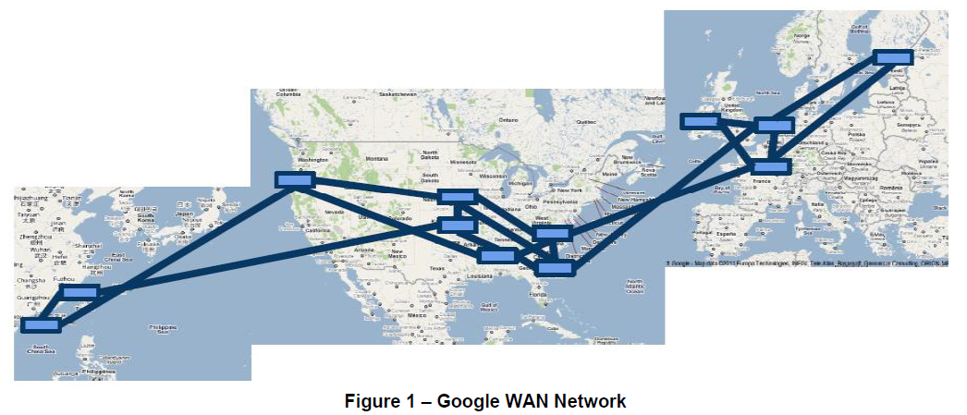
SDN use case – google inter-datacenter
Why?
significant amount of data to be moved from one region to another
Need Inter-Datacenter WAN with centralized Traffic Engineering(TE) using SDN and OpenFlow
Problem?
non-linear complexity in management and configuration.”
Source: “Migration Use Cases and Methods”, Migration Working Group, ONF 2013

Slide 5
Google Networks
Data Center Networks
Use merchant silicon chips
Centralized control planes
B4:
A software-defined WAN that supports multiple traffic classes
Use merchant silicon chips
Centralized control planes
B2:
A Global WAN for user-facing traffic
Vendor gear
Decentralized control plane
These differences increase management complexity and pose
availability challenges
Source: “Migration Use Cases and Methods”, Migration Working Group, ONF 2013

Slide 6
Operational mode
Traffic
user data copies (e.g., email, documents, audio/video files) to remote datacenters for availability/durability
remote storage access for computation over inherently distributed data sources
large-scale data push synchronizing state across multiple datacenters
Objective
Leverage control at the network edge to adjudicate among competing demands during resource constraint: network load balancing
Use multipath forwarding/tunneling to leverage available network capacity according to application priority
Dynamically reallocate bandwidth in the face of link/switch failures or shifting application demands
run at near 100% utilization and all links to average 70% utilization over long time periods, corresponding to 2-3x efficiency improvements relative to standard practice.

Slide 7
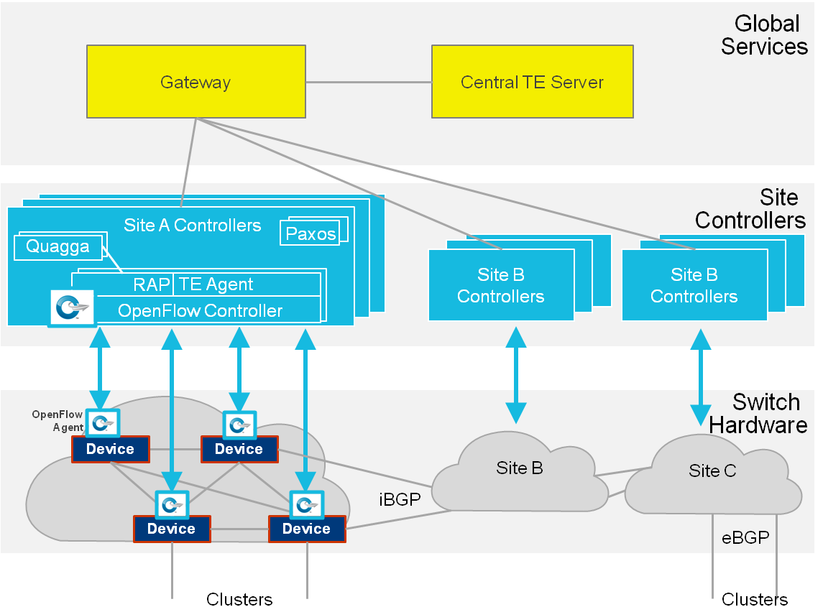
Architecture: B4
Traffic engineering using prioritized switch forwarding table entries on the top of baseline routing protocol: red button to fall back to shortest path routing facing critical issues
Load balancing: a custom variant of Equal Cost Multipath (ECMP) hashing
uses a hash algorithm to choose one of the next-hop addresses among ECMP set
EBGP: external BGP runs between routers in different ASs
IBGP: internal BGP runs between routers in the same AS

Slide 8
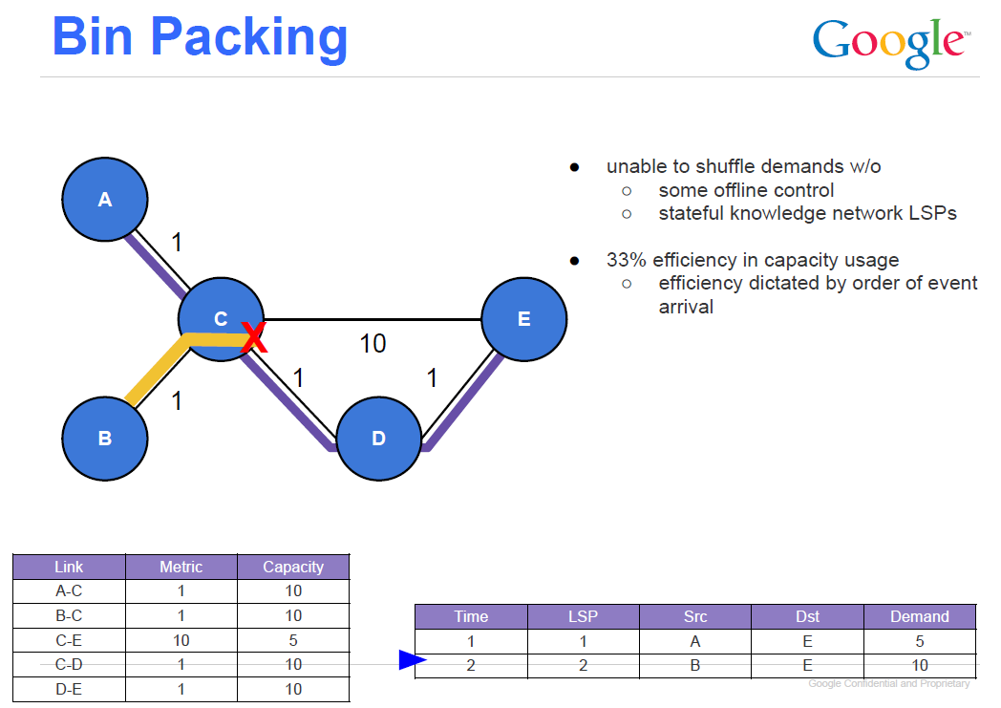
Why open system?: Traffic Engineering
Google’s WAN
Internet side (user traffic)
To/From external flows
Manage the WAN as a system (Current Internet: node centric)
Separate hardware from software
Logically centralized network control
Deadlock Resolution, Bin Packing, Scheduling/Calendaring, Predictability
LSP: Label Switched Path, a path through an MPLS network (tunnel path)

Slide 9
SDN Applications: Google’s view
Having a centralized view allows new applications.
Many of these applications require novel research. A few of the most interesting to us are:
Traffic Engineering
Intra-domain
Inter-domain egress
optimization
scheduling
control theory
Security
Event Based Control

Slide 10
Evolve or Die: High-Availability Design Principles
Drawn from Google’s Network Infrastructure
Slides are uploaded to KLMS “google-Evolve-Ramesh-Slides.pdf”
By learning from failures
A small mistake by operator can impact a large part of network
From 100 Postmortem reports written over a 2 year period
70% of failures occur when management plane operation is in progress
Failures are everywhere: all three networks and three planes see comparable failure rates
80% of failure durations between 10 and 100 minutes ➔ too long
Re-think the Management Plane
Operator types wrong CLI command, runs wrong script ➔ Minimize Operator Intervention
To upgrade part of a large device… ➔ … proceed while rest of device carries traffic
Ensure residual capacity > demand ➔ Assess risk continuously
Avoid and Mitigate Large Failures
Design fallback strategies ➔ e.g.) Fallback to B2!
Make change the common case
Make it easy and safe to evolve the network daily

Slide 11
Evolve or Die: High-Availability Design Principles
Drawn from Google’s Network Infrastructure http://www.layer9.org/
http://www.layer9.org/2016/08/sigcomm-2016-session-2-wide-area.html
Q1) Is there an place in this work for formal methods?
A) Our paper discusses this, formal methods have not been applied at large scale networks. However, there is recent work on data plane and control plane verification and space is there for work in formal methods.
Q2) Has Google ever pressed the red button?
A) The answer is beyond my pay grade.

